Slide 1
LESSON 1

Slide 2


Pen
Write

Slide 3
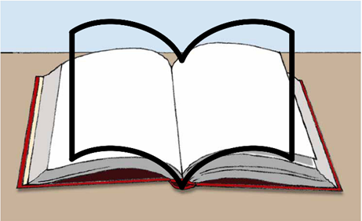

Book
Read
Learn

Slide 4

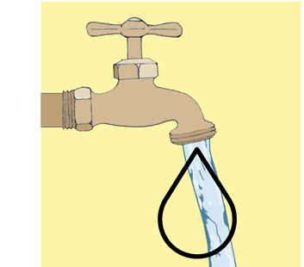
Water

Slide 5
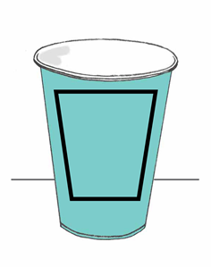

Cup
Drink

Slide 6
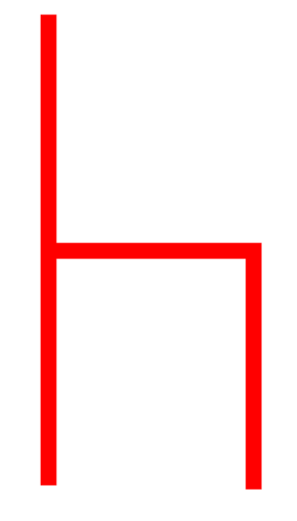
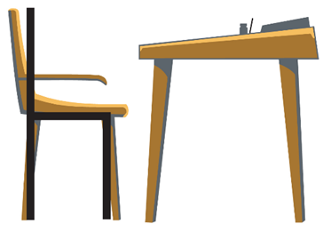
Chair
Sit

Slide 7

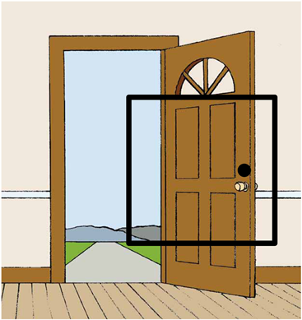
Door

Slide 8
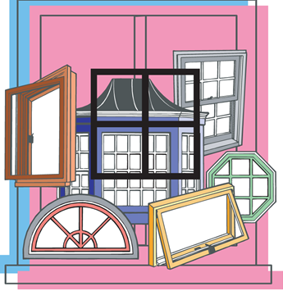
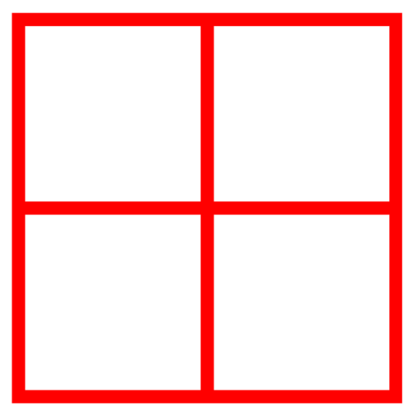
Window

Slide 9
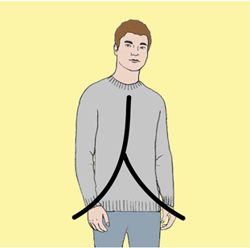
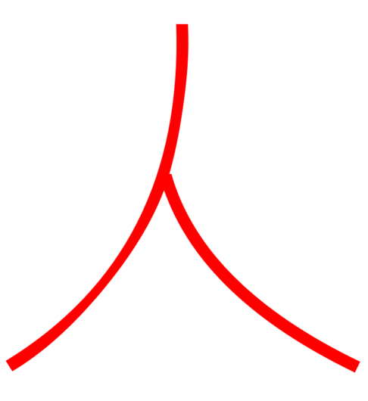
Person

Slide 10
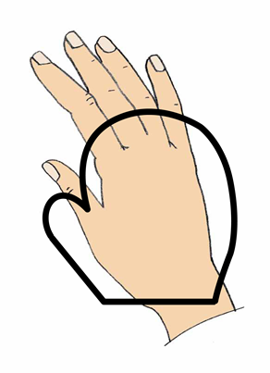

Hand

Slide 11
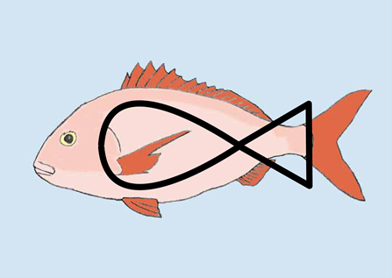

Fish

Slide 12

Notes:
A person drinks.

Slide 13
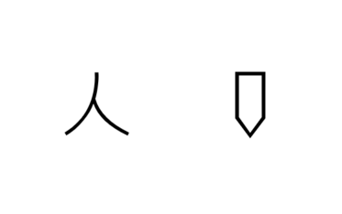
Notes:
A person writes.

Slide 14

Notes:
A person reads.

Slide 15
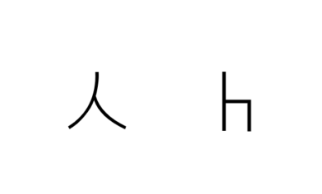
Notes:
A person sits.

Slide 16
LESSON 2

Slide 17
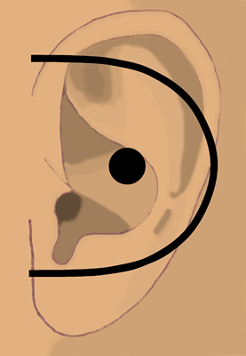

Ear
Hear

Slide 18
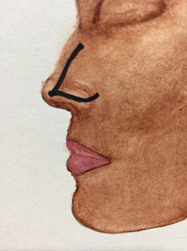
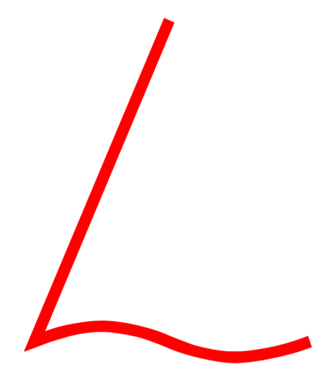
Nose
Smell

Slide 19
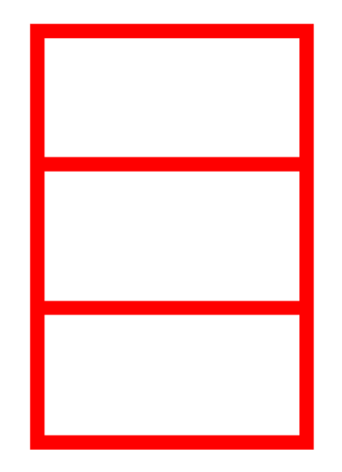
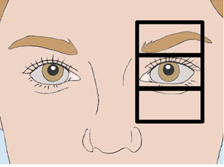
Eye
See

Slide 20
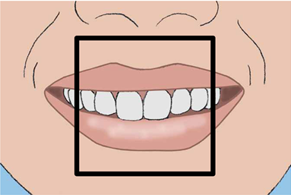

Mouth
Said
Speak

Slide 21
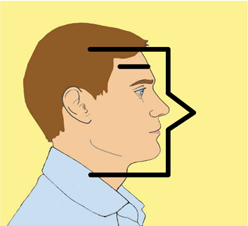
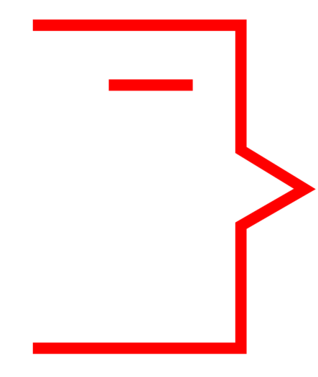
Man

Slide 22


Moon
Night

Slide 23
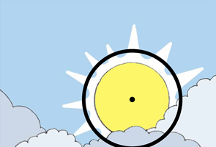

Sun
Day

Slide 24
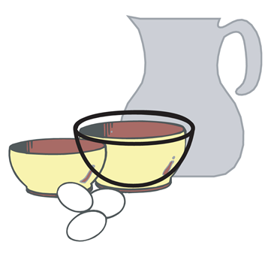
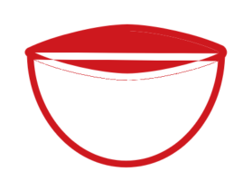
Bowl
Dish

Slide 25
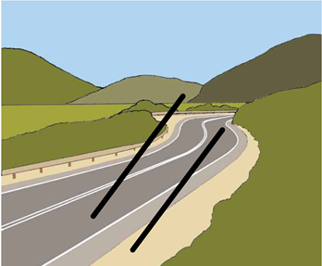

Road
Path
Way

Slide 26
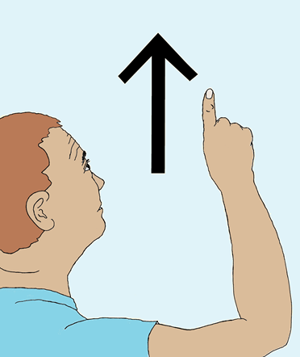
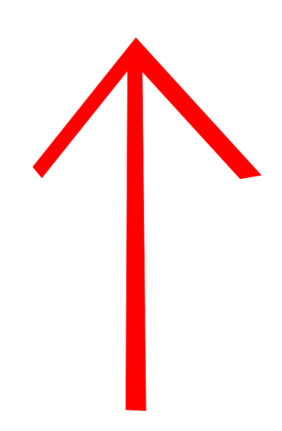
Up

Slide 27

Notes:
A man smells a fish.

Slide 28

Notes:
A man sees the moon.

Slide 29
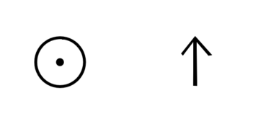
Notes:
The sun comes up.

Slide 30
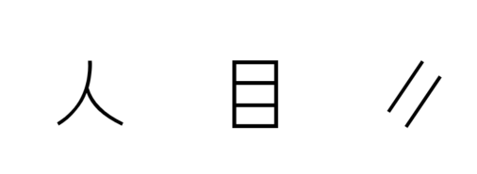
Notes:
A person sees the road.

Slide 31
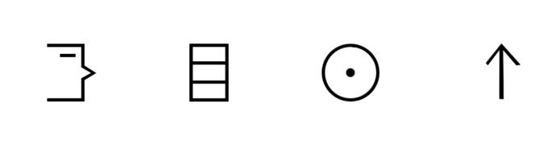
Notes:
A man sees the sun come up.

Slide 32

Notes:
A man hears a person speaking.

Slide 33
LESSON 3

Slide 34
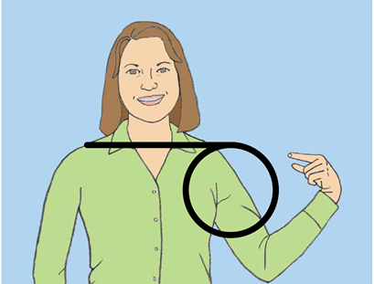
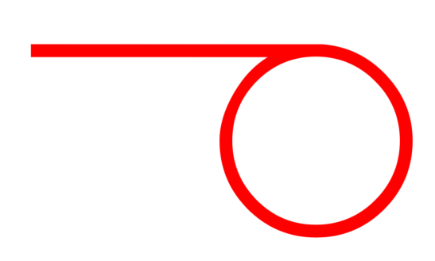
Me

Slide 35
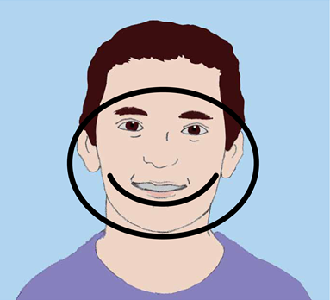

Face

Slide 36
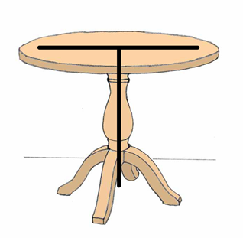

Table

Slide 37
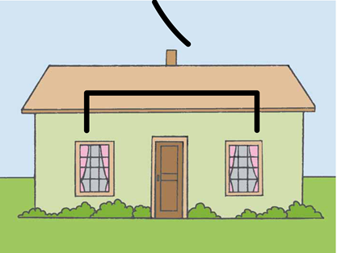
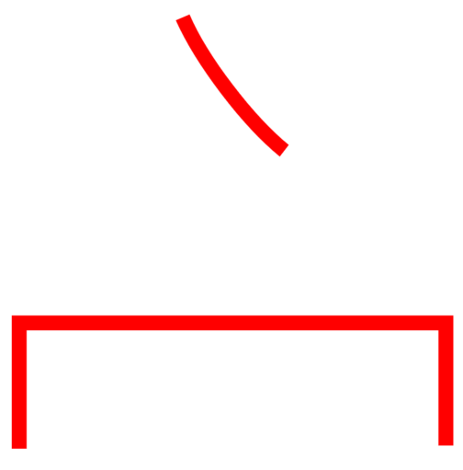
House

Slide 38
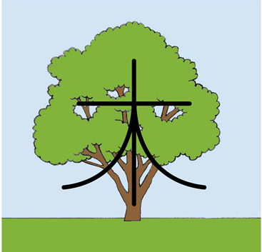
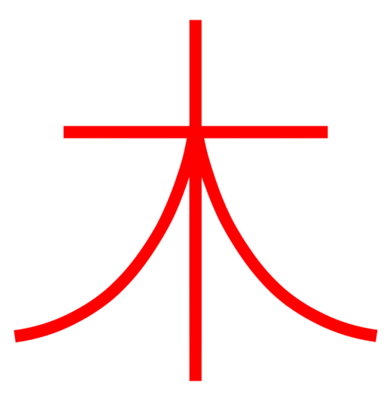
Tree
Plant

Slide 39
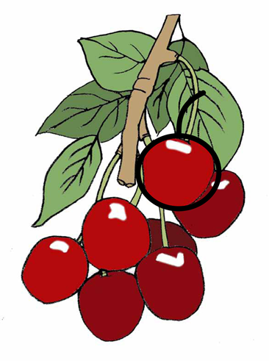
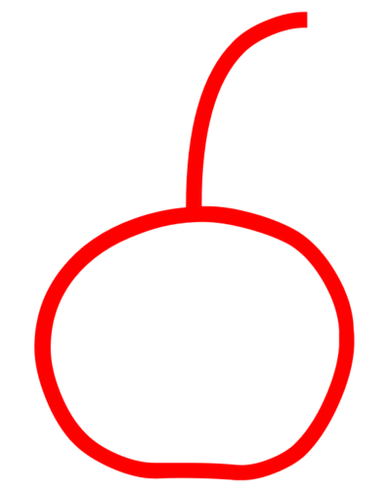
Fruit

Slide 40
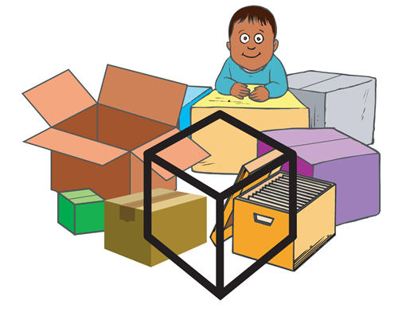

Box

Slide 41
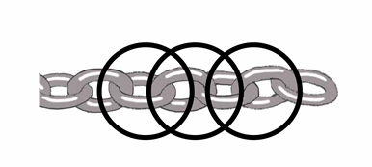
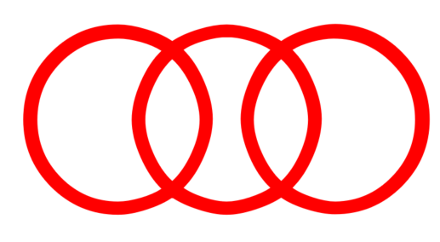
Chain
Bound
Arrest

Slide 42


No

Slide 43
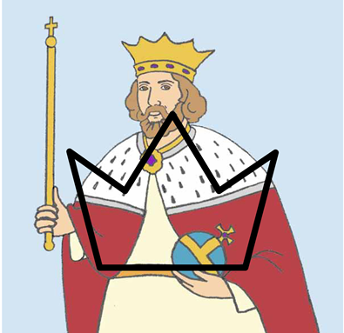

King
Lord
Ruler
Crown

Slide 44

Notes:
The king speaks to me.

Slide 45
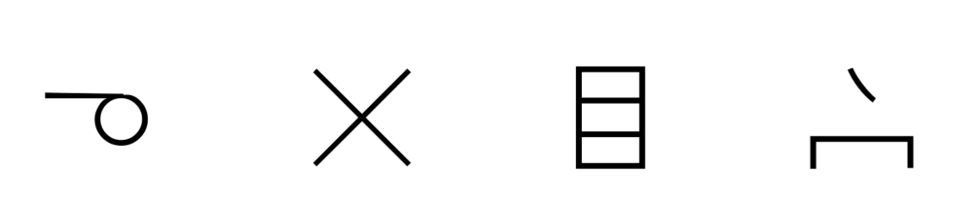
Notes:
I don’t see the house.

Slide 46
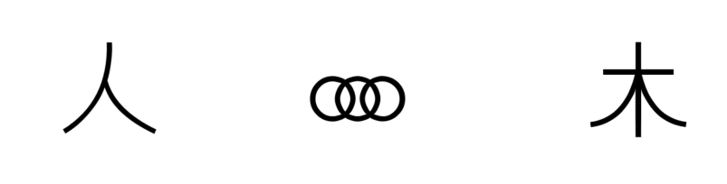
Notes:
A person is chained to a tree.

Slide 47

Notes:
The table has a box of fruit.

Slide 48
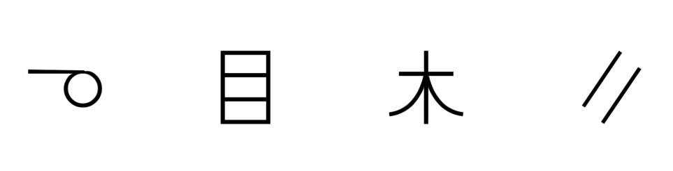
Notes:
I see a tree on the road.

Slide 49
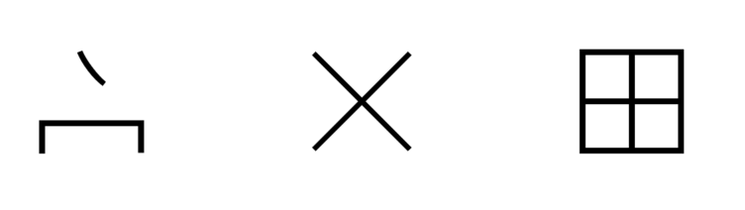
Notes:
The house has no windows.

Slide 50
LESSON 4

Slide 51

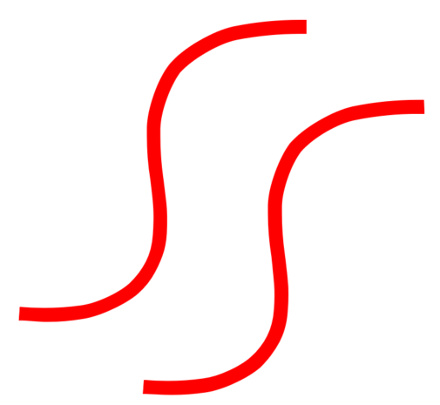
River
Stream

Slide 52


Boat

Slide 53


Storm

Slide 54


Walk

Slide 55


Knife
Cut

Slide 56


Sword

Slide 57


Belt

Slide 58


Stick

Slide 59


Grain
Wheat

Slide 60


Stair
Level

Slide 61

Notes:
I walk the road to the house.

Slide 62

Notes:
There is no boat in the storm.

Slide 63

Notes:
A person walks up the stairs.

Slide 64

Notes:
A man cuts the fruit on the table.

Slide 65

Notes:
The king has no belt.

Slide 66

Notes:
The man cuts the grain.

Slide 67
LESSON 5

Slide 68


Animal

Slide 69


Pig

Slide 70


Snake

Slide 71


Camel

Slide 72


Horse

Slide 73


Insect

Slide 74


Hole

Slide 75


Tie
Knot

Slide 76


Stretch

Slide 77


Equal
Same

Slide 78

Notes:
The man stretches the belt.

Slide 79

Notes:
A horse is tied to a tree.

Slide 80

Notes:
The pig does not walk.

Slide 81

Notes:
A horse is not the same as a camel.

Slide 82

Notes:
A person ties a belt.

Slide 83

Notes:
The house does not have any animals.

Slide 84
LESSON 6

Slide 85


Fire
Hot
Heat

Slide 86


Fire
Hot

Slide 87


Net

Slide 88


Mountain

Slide 89


Heart

Slide 90


Work
Do

Slide 91


Fly

Slide 92


Sweet

Slide 93


Straight

Slide 94


Soft

Slide 95

Notes:
I cut a hole in the box.

Slide 96

Notes:
The sun is hot.

Slide 97

Notes:
The insect flies straight.

Slide 98

Notes:
The fruit is sweet.

Slide 99

Notes:
The man sees a hole in the net.

Slide 100

Notes:
Fire goes up from the mountain.

Slide 101
LESSON 7

Slide 102


Bone

Slide 103


Wall

Slide 104


Tower

Slide 105


Land
Ground
Place
Space
Earth

Slide 106


Shield
Protect

Slide 107


Whip

Slide 108


Measure

Slide 109


Left

Slide 110


Time

Slide 111


Cross

Slide 112

Notes:
The fish has no bones.

Slide 113

Notes:
The animal works the grain field.

Slide 114

Notes:
The tower is to the left of the wall.

Slide 115

Notes:
I whip the horse.

Slide 116

Notes:
A man measures the stick.

Slide 117

Notes:
I do not have time to write.

Slide 118
LESSON 8

Slide 119


Part
Some

Slide 120


All
Whole
Every

Slide 121


Color

Slide 122


Good

Slide 123


Start
Beginning

Slide 124


From

Slide 125


Air

Slide 126


Love
Compassion

Slide 127


Know
Knowledge

Slide 128


New

Slide 129

Notes:
The king loves his horses.

Slide 130

Notes:
The man has a good heart.

Slide 131

Notes:
I see all colors.

Slide 132

Notes:
No air is coming from the mouth.

Slide 133

Notes:
I write a new book.

Slide 134

Notes:
I don’t know the person.

Slide 135
LESSON 9

Slide 136


Zero

Slide 137


One

Slide 138


Two

Slide 139


Three

Slide 140


Four

Slide 141


Five

Slide 142


Six

Slide 143


Seven

Slide 144


Eight

Slide 145


Nine

Slide 146


Ten

Slide 147
LESSON 10

Slide 148


Thing

Slide 149


Clothing
Fabric

Slide 150


Number

Slide 151


Thousand

Slide 152


Many

Slide 153


Near

Slide 154


Small

Slide 155


Very
Showing Emphasis

Slide 156


People
Two Person
More than one person is people.

Slide 157


Woman
Man + (long hair)
Woman sometimes have long hair.

Slide 158
LESSON 11

Slide 159


Crowd
Multitude
Four People
Four people represents a lot of people, which is a crowd or multitude.

Slide 160


Closed
Doors together
When doors are touching each other, the entrance is closed.

Slide 161


Open
No + closed
Something that is not closed is open.

Slide 162


In
Inside
Door + thing
A thing inside another object.

Slide 163



On
Thing + Arrow pointing to the top of thing
Something that is on another object or on top of something.

Slide 164


Away
Thing + Arrow going away
Object moving away from current location

Slide 165


Deaf
No + Ear
If your ear does not work, you are deaf.

Slide 166


Mute
Mouth + No
When there is nothing coming out of a person’s mouth, that person is mute.

Slide 167


Put
Hand + Thing
This hand is facing downward putting an object down on a table.

Slide 168


Touch
Hand touching a thing.

Slide 169
LESSON 12

Slide 170


Take
Carry
Bring
Hand + Thing
When you have a thing in your hand, you are carrying, taking or bringing it somewhere.

Slide 171


Tongue
Mouth + Fabric
The fabric-like thing in your mouth is your tongue.

Slide 172


Spit
Mouth + Forward + Water
To spit is to throw out the water that comes from the mouth.

Slide 173


Sigh
Mouth + Air
A sigh is the sound you make when air comes out of your mouth.

Slide 174


Freed
Free
Chain + No
When you are free, you are not chained.

Slide 175


Desire
Will
Want
Love + Heart
When your heart loves something, you desire it.

Slide 176


Beg
Plead
Very + Mouth + Desire
When you are emphatically talking about something you desire, you are begging.

Slide 177


Jesus
King + Cross
Jesus is the King on the cross.

Slide 178


Father
Man + Love
A man that has a son or daughter.

Slide 179


God
King + Father
God is King and Father of Jesus Christ and those who believe in Jesus.

Slide 180


Heaven
House + God
Heaven is God’s house.

Slide 181
LESSON 13

Slide 182


Period
This symbol marks the end of a complete thought.

Slide 183

Comma
This symbol indicates a break within a complete thought.

Slide 184

Quotation Marks
These symbols appear at the beginning and end of something that someone says.

Slide 185

Question Mark
This symbol indicates a question is being asked.

Slide 186

Exclamation Point
This symbol marks the end of a sentence spoken with emphasis or strong emotion.

Slide 187

Notes:
They brought to Jesus someone who was deaf and had difficulty speaking.

Slide 188

Notes:
They begged Jesus to lay his hand on him.

Slide 189

Notes:
Jesus took him aside from the crowd privately.

Slide 190

Notes:
Jesus put His fingers into his ears.

Slide 191

Notes:
After spitting

Slide 192

Notes:
Jesus touched his tongue.

Slide 193

Notes:
Jesus looked up to Heaven.

Slide 194

Notes:
Jesus sighed.

Slide 195

Notes:
Jesus said to him “ Ephphatha, “ that is to say, “Open!”

Slide 196

Notes:
Immediately his hearing was opened.

Slide 197

Notes:
His tongue was loosened. What prevented his tongue was destroyed.

Slide 198

Notes:
He could speak clearly.

